Slide 1
The World’s Leading Designation for Finance Professionals
in
a Data-Driven Industry
FDP Institute - Town Hall
Testing: We Have Options!
July 24, 2020
www.fdpinstitute.org
Mehrzad Mahdavi
Executive Director, FDPI
Hossein Kazemi
Sr. Advisor FDPI
Sr. Advisor CAIA
Mirjam Dekker
Project Manager, FDPI
Notes:
Mirjam

Slide 2
Agenda
The FDP Program
The FDP Exam
Exam Test Options
Inform attendees of available options
Ensure all attendees can make a decision that best fits their needs
Q&A
2
Notes:
Mirjam

Slide 3
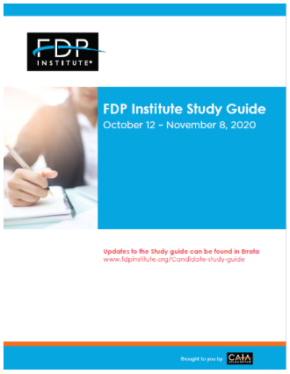
FDP Program: Requirements
One Comprehensive exam
75 Multiple Choice (60% of total grade)
3-4 Essay questions (40% of total grade)
Two online classes
Introduction to programming for data scientists: Python or R.
Approved providers: Datacamp, Dataquest, Metis.
4-8 hours to complete each class (Datacamp, Dataquest).
Can be completed before or after your FDP exam
Costs: as low as 25 USD.
Start here:
Download the study guide
Download the curriculum readings listed (most are free of charge)
Review the pages of readings / books that are assigned in the study guide. Not everything is covered on the exam.
>> Updates to Study Guide can be found in the Errata

Slide 4
FDP Program: Exam - Curriculum Topics
Topics | Exam Weight %
Topic 1: Introduction to Data Science & Big Data | 5-10
Topic 2: Machine Learning: Introduction to Algorithms | 5-10
Topic 3: Machine Learning: Regression, Support Vector Machine & Time Series Models | 5-10
Topic 4: Machine Learning: Regularization, Regression Trees, Random Forest & Overfitting | 5-10
Topic 5: Machine Learning: Classification & Clustering | 5-10
Topic 6: Machine Learning: Performance Evaluation, Back-testing & False Discoveries | 5-10
Topic 7: Data Mining & Machine Learning: Naive Bayes & Text Mining | 5-10
Topic 8: Big Data & Machine Learning: Ethical & Privacy Issues | 5-10
Topic 9: Big Data & Machine Learning in the Financial Industry | 30-50
4

Slide 5
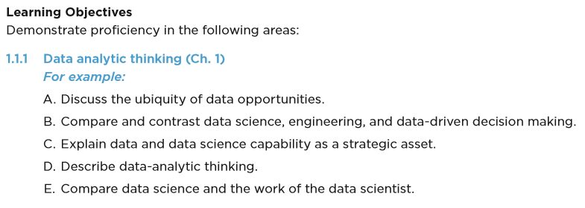
FDP Program: Exam - Curriculum Topics
Topics, Learning Objectives & Keywords
KEYWORDS
READING 1
Provost, F. & T. Fawcett. (2019) Data Science for Business
Chapter 1 & 2
TOPIC 1
Introduction to Data Science & Big Data
LEARNING OBJECTIVE 1
LEARNING OBJECTIVE 2
READING 2

Slide 6
FDP Program: Exam - Sample Questions
Knowing the equations: Example
Understanding properties of algorithms: Example
Doing the calculations: Example
IDF(t) is the inverse document frequency of a term t. The term NOT_t occurs in every document that does not contain t. Given this, what is the most accurate representation of entropy?
A entropy = p*IDF(t) - (1-p)*IDF(Not_t)
B* entropy = p*IDF(t) + (1-p)*IDF(Not_t)
C entropy = (1- p)*IDF(t) + (p)*IDF(Not_t)
In the context of supervised learning methods, what kind of variance and bias do underfitted models tend to have in their predictions?
A* Low variance and high bias
B High variance and low bias
C High variance and high bias
Research has shown that 8% of hedge fund managers are skilled enough to have positive alphas. The performance of a group of randomly selected hedge fund managers is tested to determine if any of them are skilled. Specificity of the test is 95% and sensitivity of the test is 80%. Which of the following is closest to the probability that a manager whose alpha is estimated to be significant is skilled?
A* 58.18%
B 59.18%
C 60.18%
Notes:
R1 – means Reading 1

Slide 7
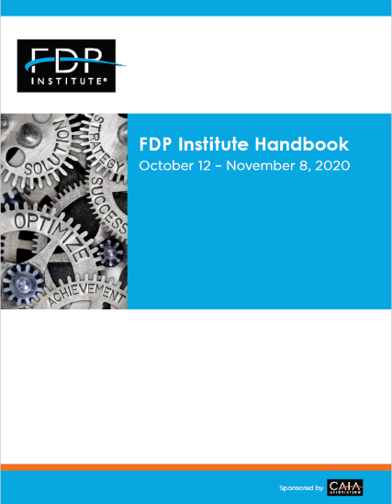
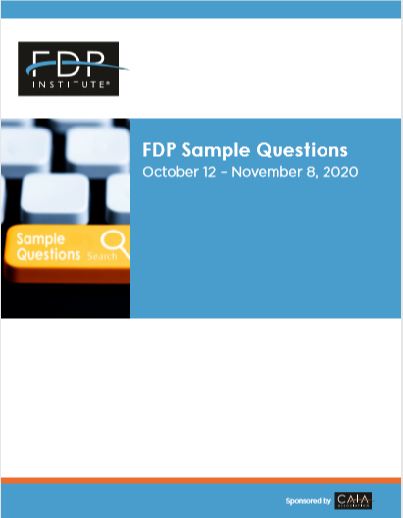
FDP Program: Exam - Study Tools
Click to download the handbook
Click to download the study guide
Click to download the book
Click to download the book
PMR
E-Book
6 required readings
$99
Exam Registrants
Topics in Financial Data Science
13 required readings
FREE ACCESS
Exam Registrants
Sample Questions
Study Tool
FREE ACCESS
Exam Registrants
Selected Chapters from 3 books
Data Science for Business
An Introduction to Statistical Learning
Big Data and Machine Learning in Quantitative Investment
Exam Registrants can look for best available price.
Approximate cost of hardcopies of books is $200
7
7

Slide 8
FDP Exam Test Options
Option 1
At a Prometric Location
Exam Window:
October 12 – November 8, 2020
Option 2
Remote Proctored Testing
Exam Day
December 1, 2020
Schedule Your Exam Seat until September 30th
If you have already scheduled your exam seat at a Prometric location and want to keep option 1 there is no action required!
In the event that your exam is canceled, you will be eligible for Option 2, to take the Remote Proctor Exam on December 1, 2020
Applications for RPT have to be received by September 30th
Schedule RPT timeslot between November 10 – 20th, 2020
Once you have selected the Remote Proctor Option, you may not reschedule an appointment at a later date at a physical location.

Slide 9
FDP Exam Test Options
Option 1
At a Prometric Location
Exam Window:
October 12 – November 8, 2020
Option 2
Remote Proctored Testing
Exam Day
December 1, 2020
2-part exam
Part 1: 65 multiple choice questions
20 minute optional break
Part 2: 10 Multiple choice questions 3-4 constructive response questions
Total 4 hours
2-part exam
Part 1: 65 multiple choice questions
20 minute optional break*
Part 2: 10 Multiple choice questions 3-4 constructive response questions
Total 4 hours
*) security check to log in approx. 10-15 minutes

Slide 10
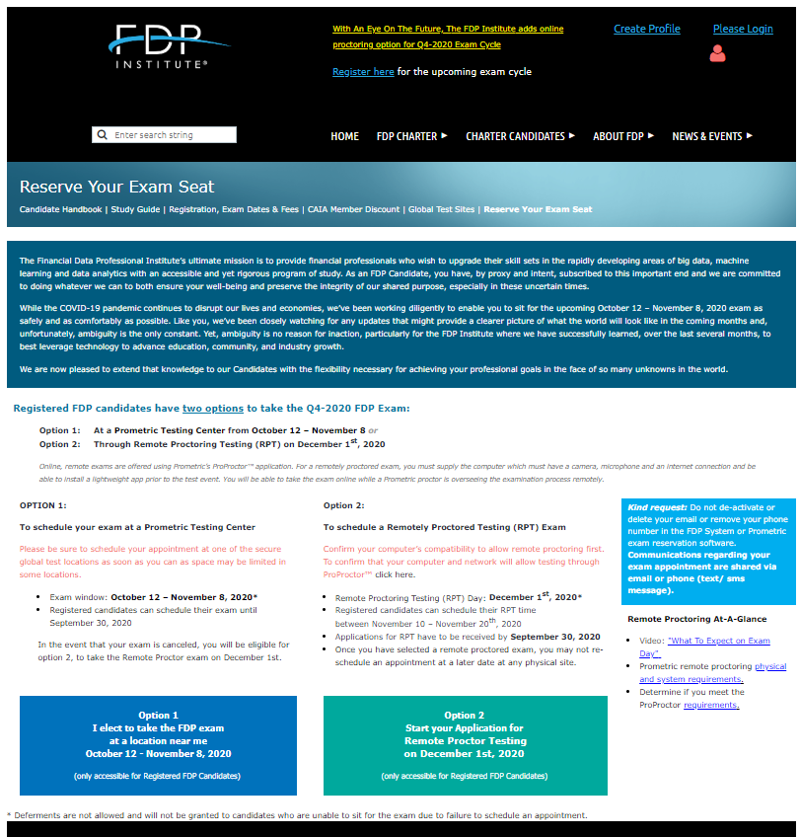
FDP Exam Option 1: Reserve Your Seat at a Prometric Location
Option 1
At a Prometric Location
Exam Window:
October 12 – November 8, 2020
www.fdpinstitute.org/reserve-your-exam-seat

Slide 11
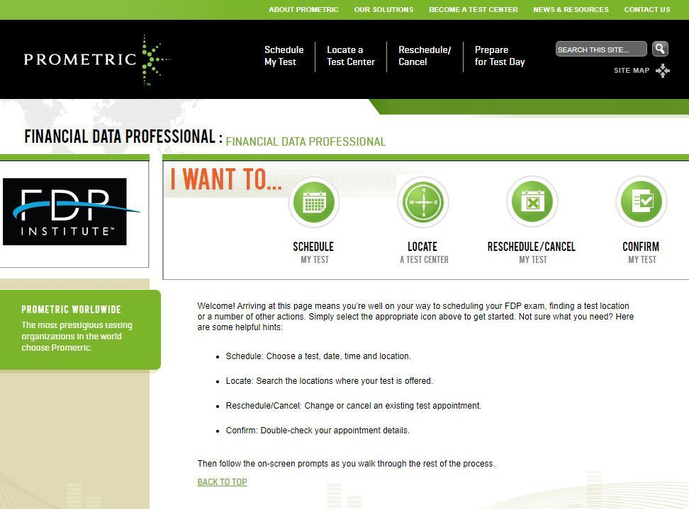
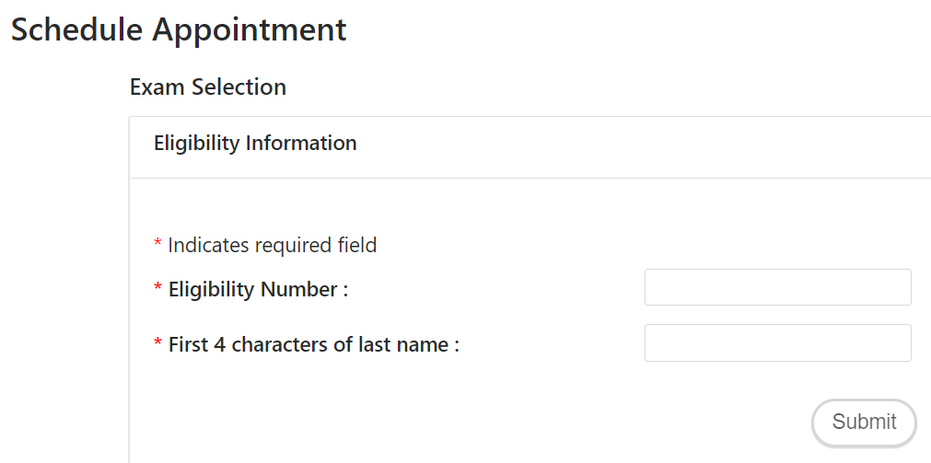
FDP Exam Option 1: Reserve Your Seat at a Prometric Location
Option 1
At a Prometric Location
Exam Window:
October 12 – November 8, 2020
https://www.prometric.com/test-takers/search/fdpi
https://www.prometric.com/test-takers/search/fdpi
Your eligibility Number is your FDP Profile Number

Slide 12
FDP Exam Option 2: Remote Proctor Testing
Option 2
Remote Proctored Testing
Exam Day
December 1, 2020
www.fdpinstitute.org/reserve-your-exam-seat
Remote Proctoring At-A-Glance
Video: "What To Expect on Exam Day"
Prometric remote proctoring physical and system requirements.
Determine if you meet the ProProctor requirements.

Slide 13
FDP Exam Option 2: Remote Proctor Testing
Option 2
At a Prometric Location
Exam Day December 1, 2020

Slide 14
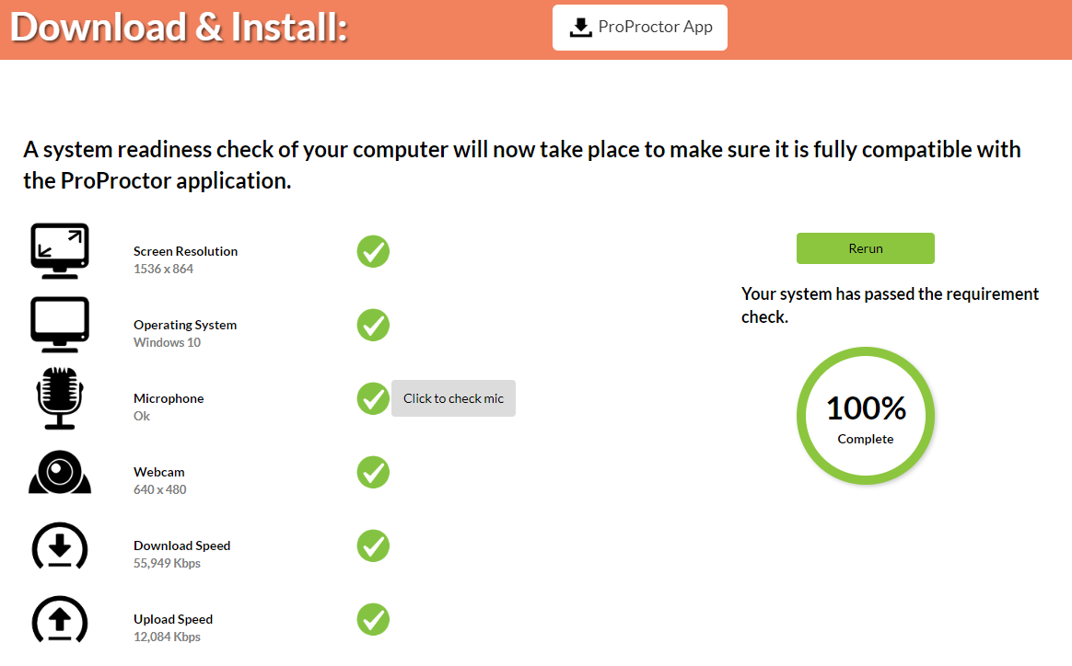
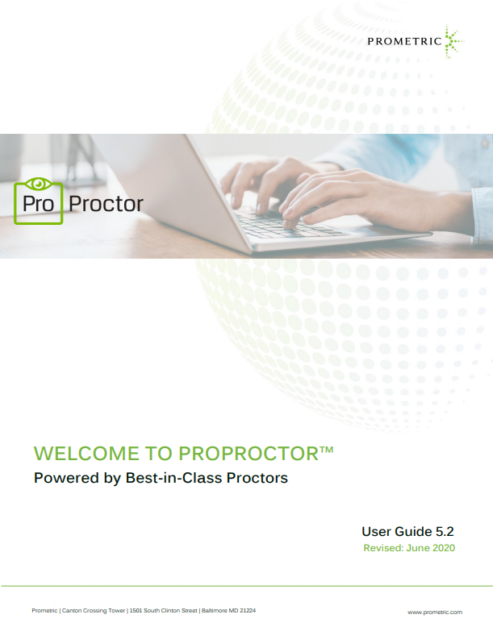
FDP Exam Option 2: Remote Proctor Testing
Option 2
At a Prometric Location
Exam Day December 1, 2020
Check the Prometric-ProProctor video on "What to Expect on Exam Day"
Carefully read the Prometric remote Proctoring User Guide physical and system requirements.
Complete the system ready check requirements.

Slide 15
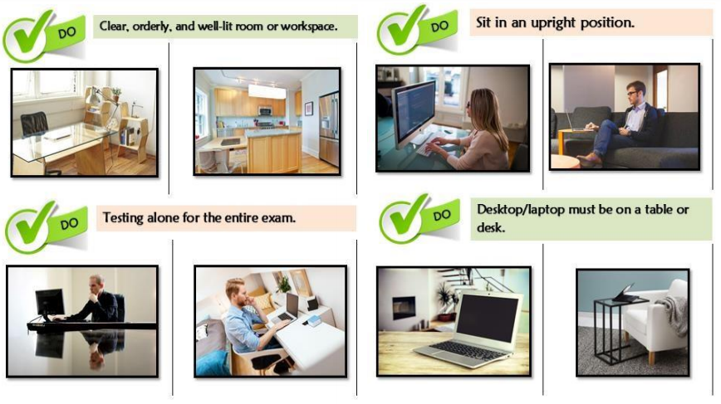
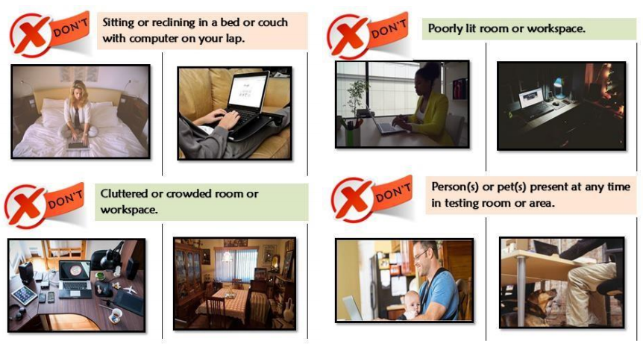
FDP Exam Option 2: Remote Proctor Testing
Option 2
At a Prometric Location
Exam Day December 1, 2020

Slide 16
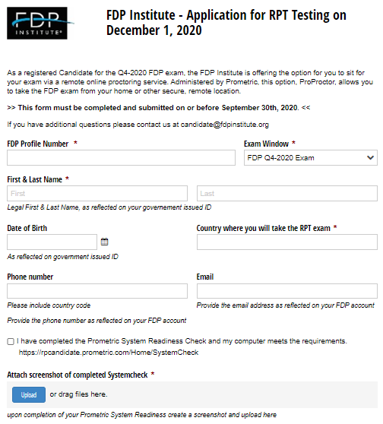
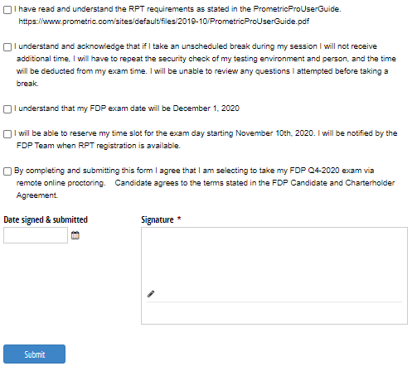
FDP Exam Option 2: Remote Proctor Testing
Complete the RPT application & submit on or before September 30th

Slide 17
FDP Program: Exam Registration & Fees
October 12 – November 8, 2020
March 29 – April 11, 2021
Exam Fees*
Registration Open | Early Registration Ends | Regular Registration Closes | FDP Exam Window
May 10, 2020 | June 20, 2020 | September 30, 2020 | October 12 – November 8, 2020
Registration Open | Early Registration Ends | Regular Registration Closes | FDP Exam Window
December 1, 2020 | January 17, 2021 | March 10, 2021 | March 29 – April 11, 2021
 | Early Registration | Standard Registration | Retake
Registration Fee (refund policy) | $950 | $1150
Enrollment Fee (non-refundable) | $400 | $400
Total | $1350 | $1550 | $450
Books and Materials Costs (approx.) | $200 | $200
CAIA Members are eligible for a 20% discount on the Registration Fee
17
17
Notes:
Mehrzad

Slide 18
Q &A
https://fdpinstitute.org/FAQs
https://fdpinstitute.org/Remote-Proctoring-FAQs

Slide 19
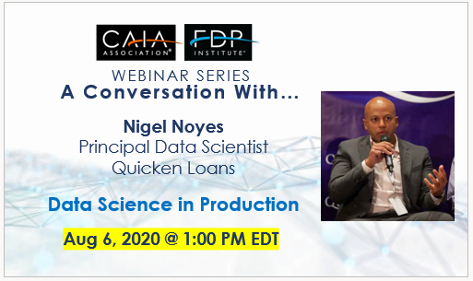
In Closing
Upcoming webinars

Slide 20
Thank You
fdpinstitute.org
Contact us: info@fdpinstitute.org
@fdpinstitute
linkedin.com/company/fdpinstitute
20

