Slide 1
Financial Data Professional Institute ”Big Data is a Big Deal: An investor’s guide to the applications and challenges of alternative data”
Mehrzad Mahdavi, Executive Director, FDP Institute
Kathy Wilkens, Senior Advisor, FDPI Curriculum Mirjam Dekker, Project Manager, FDP Institute
www.fdpinstitute.org
January 29, 2020
Notes:
Mirjam - introductions

Slide 2
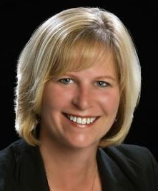
Agenda
Welcome, Introductions
About LOIM / 1798 Q
Big Data whitepaper
Terms
A “third way” for investment insights
Alternative data sources
Growth of alternative data
Technical challenges
Fundamental headwinds
Maintaining a lead
FDP Curriculum
Q & A
Gene Getman , CAIA
Author of “Big Data is a Big Deal”
Kathryn Wilkens, CAIA
Sr. Curriculum Advisor FDPI
Mehrzad Mahdavi
Executive Director
FDPI
Mirjam Dekker
Project Manager
FDPI
Notes:
Mirjam

Slide 3
About Lombard Odier Investment Managers
Notes:
What is the 1798 Q Strategy?

Slide 4
FDP Program & Required Readings
Notes:
Kathy: Transition slide introducing the curriculum readings

Slide 5
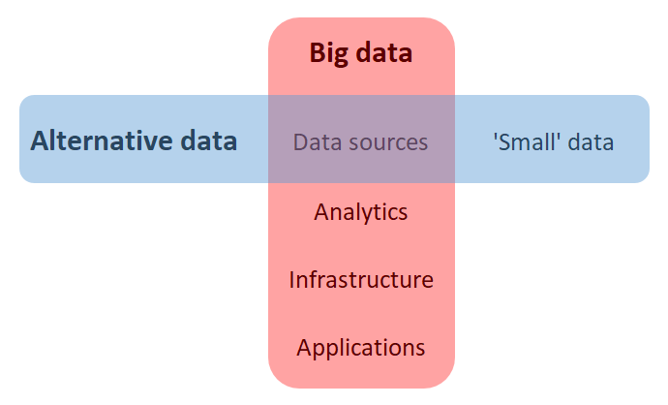
Terms
Lombard Odier Investment Managers.
Please see important information about the Lomabrdier slides at the end of this slide deck

Slide 6
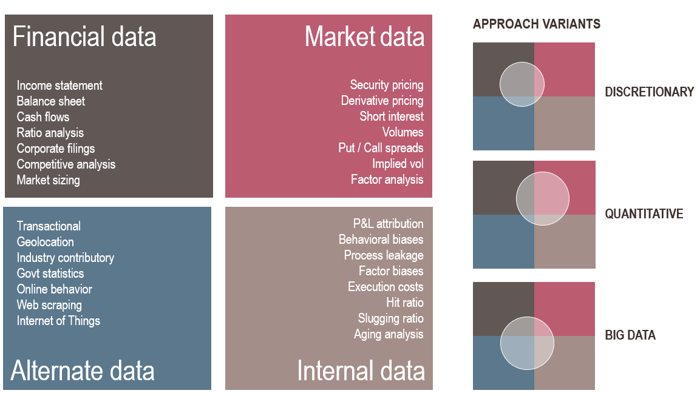
A “third way” for investment insights
Lombard Odier Investment Managers.
Please see important information about the Lomabrdier slides at the end of this slide deck

Slide 7
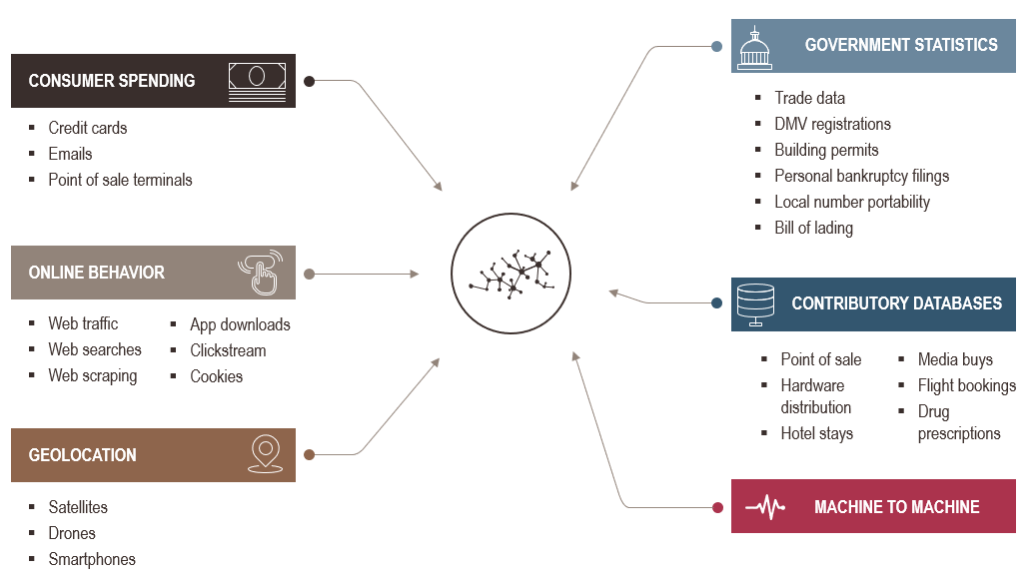
Alternative data sources Combination of multiple sources provides mosaic of information
Lombard Odier Investment Managers.
Please see important information about the Lomabrdier slides at the end of this slide deck

Slide 8
The Golden Age of Data Science
Growth in data being created
Alternative data¹
Period of dramatic leadership change
Internal data
Market data
Financial data
¹Source: IDC’s Data Age 2025 study, April 2017
²Typical margin of error for forecasted company valuation metrics vs actual corporate earnings results.
Lombard Odier Investment Managers.
Please see important information about the Lomabrdier slides at the end of this slide deck

Slide 9
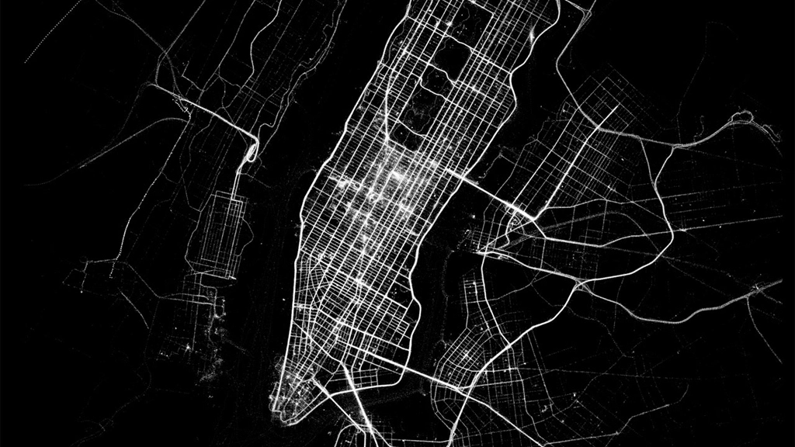
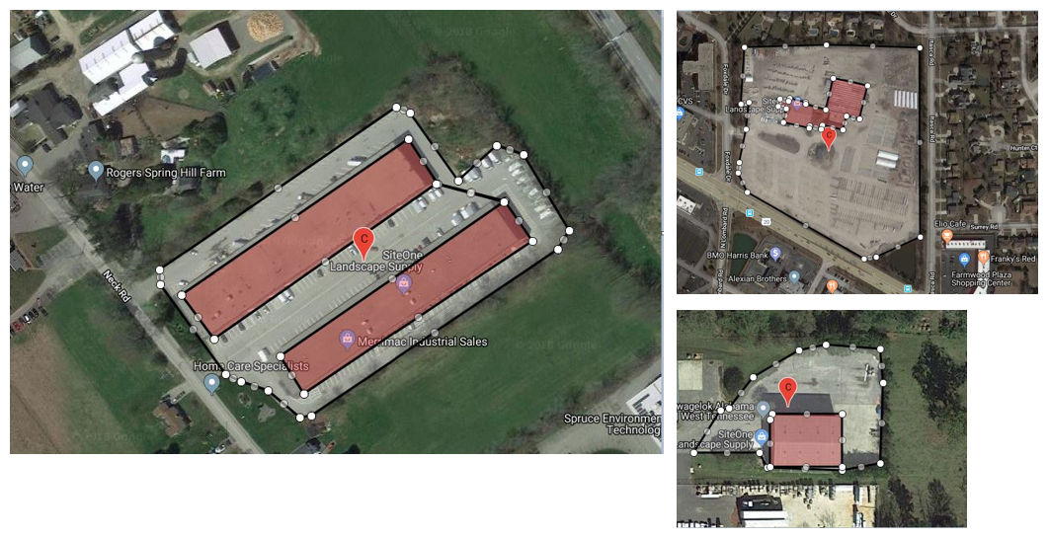
Technical Challenges
Accuracy and availability of datasets 1 - 10
Geolocation sample
Lombard Odier Investment Managers.
Please see important information about the Lomabrdier slides at the end of this slide deck

Slide 10
Fundamental Headwinds
Alignment of culture
Top-level buy-in
Patience
Cost of the exercise
Lombard Odier Investment Managers.
Please see important information about the Lomabrdier slides at the end of this slide deck

Slide 11
Maintaining a Lead
Efficiency and experience with respect to evaluating, refining, and contextualizing data is more paramount than access to scale and resources
Lombard Odier Investment Managers.
Please see important information about the Lomabrdier slides at the end of this slide deck

Slide 12
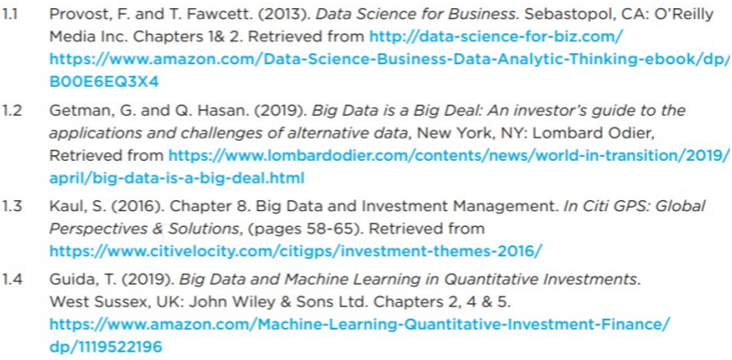
FDP Curriculum
1. Introduction to Data Science & Big Data
Reading(s):
2. DM & ML: Introduction
3. DM & ML: Regression, LASSO, Predictive Models, Time Series & Tree Models
4. DM & ML: Classification & Clustering
5. DM & ML: Performance Evaluation, Backtesting & False Discoveries
6. DM & ML: Representing & Mining Text
Sample Keywords:
7. Big Data, DM & ML: Ethical & Privacy Issues
8. Big Data and Machine Learning in the Financial Industry
Notes:
Kathy

Slide 13
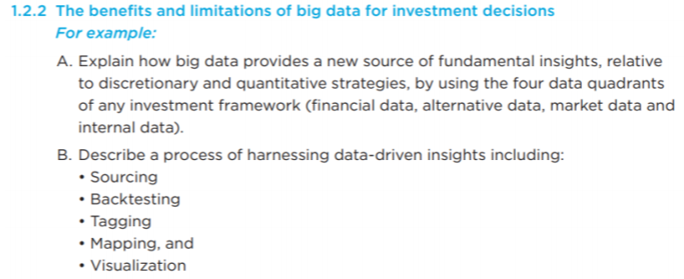
FDP Curriculum
1. Introduction to Data Science & Big Data
Sample Learning Objectives
2. DM & ML: Introduction
3. DM & ML: Regression, LASSO, Predictive Models, Time Series & Tree Models
4. DM & ML: Classification & Clustering
5. DM & ML: Performance Evaluation, Backtesting & False Discoveries
Sample Question:
In the article “Big Data is a Big Deal,” there are three main types of manager orientations (legacy fundamental, legacy quantitative, and big data) which use various combinations of four types of data sources. Examples are given for each of the four categories. Which type of manager orientation is most likely to rely on implied volatility data and factor analysis data?
Fundamental
Quantitative*
Big data
Answer Key → LO 1.2.2. p.9
6. DM & ML: Representing & Mining Text
7. Big Data, DM & ML: Ethical & Privacy Issues
8. Big Data and Machine Learning in the Financial Industry
Notes:
Kathy

Slide 14
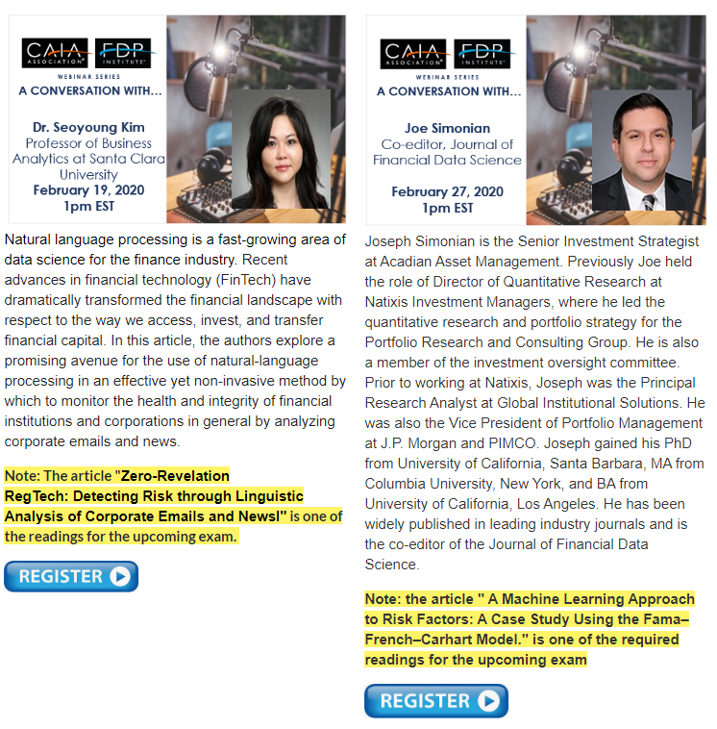
Q & A
Kind reminders of upcoming webinars as we go through the Q & A.
Add your questions in the chat room please.

Slide 15
In Closing
Upcoming webinars
Contact Gene Getman gene.getman@lombardodier.com
Learn more about the FDP Institute at www.fdpinstitute.org

Slide 16
Important information (1/2)
This presentation (i) is not, nor is it intended to be, marketing material or advertising within the meaning of the Investment Advisers Act of 1940, the rules and guidance of the Securities and Exchange Commission (“SEC”) or the Conduct Rules of the Financial Industry Regulatory Authority (“FINRA”), (ii) is for informational use only by the receiving party for general due diligence purposes, and (iii) is not intended to be an offer to invest in any security. Any such offer will only be made pursuant to delivering of definitive documentation.
This document is the property of LOIM and is addressed to its recipient exclusively for their personal use. It may not be reproduced (in whole or in part), transmitted, modified, or used for any other purpose without the prior written permission of LOIM. It is not intended for distribution, publication, or use in any jurisdiction where such distribution, publication, or use would be unlawful. This information is strictly confidential and may not be reproduced for, disclosed to or otherwise provided in any format to any other person or entity without the prior written consent of Lombard Odier Asset Management (USA) Corp., or one of its affiliates (together, “LOIM”).
This document is not a recommendation to subscribe to and does not constitute an offer to sell or a solicitation or an offer to shares of any investment vehicle (“Fund”) nor shall there be any sale of Fund shares in any jurisdiction in which such offer, solicitation or sale would be unlawful. Consequently, the offering of Fund shares may be restricted in certain jurisdictions. Prospective investors must inform themselves of, and observe, such restrictions, including legal, tax, foreign exchange or other restrictions in their relevant jurisdictions. Neither this document nor any part of it shall form the basis of, or be relied on in connection with, any contract to purchase or subscription for Fund shares. Any such acquisition may only be made on the basis of the official documents of a Fund each in their final form. The confidential memorandum, the memorandum and articles of association and the subscription agreement are the only official offering documents of any Fund shares (the “Offering Documents”).
There can be no assurance that investment objective will be achieved or that there will be a return on capital. Past or estimated performance is not necessarily indicative of future results and no assurance can be made that profits will be achieved or that substantial losses will not be incurred. This document does not contain personalized recommendations or advice and is not intended to substitute any professional advice on investment in financial products. Before making an investment in a Fund, an investor should read the entire Offering Documents, and in particular the risk factors pertaining to an investment in such Fund, consider carefully the suitability of such investment to his/her particular circumstances and, where necessary, obtain independent professional advice in respect of risks, as well as any legal, regulatory, credit, tax, and accounting consequences.
An investment in this strategy is not suitable for all investors. Making an investment in a Fund is speculative. The contents of this document are intended for persons who are sophisticated investment professionals and who are either authorized or regulated to operate in the financial markets or persons who have been vetted by LOIM as having the expertise, experience and knowledge of the investment matters set out in this document and in respect of whom LOIM has received an assurance that they are capable of making their own investment decisions and understanding the risks involved in making investments of the type included in this document or other persons that LOIM has expressly confirmed as being appropriate recipients of this document. If you are not a person falling within the above categories, you are kindly asked to either return this document to LOIM or to destroy it and are expressly warned that you must not rely upon its contents or have regard to any of the matters set out in this document in relation to investment matters and must not transmit this document to any other person.
This document contains the opinions of LOIM, as at the date of issue. The information and analysis contained herein are based on sources believed to be reliable. However, LOIM does not guarantee the timeliness, accuracy, or completeness of the information contained in this document, nor does it accept any liability for any loss or damage resulting from its use. All information and opinions as well as the prices indicated may change without notice.
HISTORICAL PERFORMANCE INFORMATION DEPICTED HEREIN IS NOT INDICATIVE OF FUTURE PERFORMANCE OR INVESTMENT RETURNS, AND ACTUAL EVENTS OR CONDITIONS MAY NOT BE CONSISTENT WITH, AND MAY DIFFER MATERIALLY FROM, THOSE DEPICTED. LOIM makes no representations or warranties as to the accuracy or completeness of such estimated performance figures, and further no such estimated performance figures shall be relied upon as a promise by, or representation by, LOIM whether as to past or future performance results.
The information presented herein is intended to be a summary only and LOIM makes no representation as to the accuracy of such information. This presentation may contain targeted returns and forward-looking statements. “Forward-looking statements,” can be identified by the use of forward-looking terminology such as “may”, “should”, “expect”, “anticipate”, “project”, “estimate”, “intend”, “continue” or “believe” or the negatives thereof, or variations thereon, or other comparable terminology. Investors are cautioned not to place undue reliance on such returns and statements, as actual returns and results could differ materially due to various risks and uncertainties. In considering any transactional history or prior performance information contained herein, investors should bear in mind that transactional history or prior performance is not necessarily indicative of future results, and there can be no assurance that the Fund will achieve comparable results. Such descriptions are provided for illustrative purposes only and there can be no assurance that LOIM will be able to implement its investment strategies in a similar manner or pursue similar transactions or be able to avoid losses.

Slide 17
Important information (2/2)
PAST PERFORMANCE IS NOT INDICATIVE OF FUTURE RESULTS.
The presentation of the exposures or risks identified in this presentation is not intended to be complete. There may be other exposures or risks, of which LOIM may or may not be aware, that would affect the performance or risks of the Fund. In addition, trading strategies may involve, among other techniques, leverage, short selling and various derivatives, each of which entails separate and distinct risks.
Alternative investments often engage in leverage and other investment practices that are extremely speculative and involve a high degree of risk. Such practices may increase the volatility of performance and the risk of investment loss, including the loss of the entire amount invested. Alternative investments may themselves invest in instruments that may be highly illiquid and difficult to value. This may also limit your ability to redeem or transfer your investment or delay receipt of redemption proceeds. We refer you to the offering materials for a more complete discussion of the risks relating to an investment in any particular alternative investment.
ITD figure since the inception of the Strategy on August 1, 2018. Performance information shown reflects pro forma adjusted net returns assuming application of a 1.50% management fee, 20% performance fee and estimated operational expenses. Performance shown net of fees and expenses and includes reinvestment of earnings, capital gains, interest and dividends. The Portfolio information reflects trading results for the track record of the sub-portfolio, 1798 Q Strategy (the “Portfolio”), that is traded and managed by Mr. Qaisar Hasan within the 1798 Fundamental Equities Master Fund. Because the Portfolio is part of a larger fund that includes other strategies managed by different portfolio managers, no investment vehicle or product achieved the specific returns shown herein.
NOTES REGARDING INDICES. Any indices cited herein are provided only as examples of general market performance. No index is directly comparable to the past or future performance of the Fund. It should not be assumed that the Fund will invest in any specific securities that comprise any index, nor should it be understood to mean that there is a correlation between the Fund’s returns and any index returns. Any case study has been provided for discussion purposes only and is no guarantee of future results of any investment in the Fund. There is no guarantee that any such investment opportunity will become available to the Fund.
S&P 500 Total Return Index. Calculated intraday by S&P based on the price changes and reinvested dividends of SPX Index.
The HFRX Equity Hedge Index is constructed by Hedge Fund Research, Inc. to represent the universe of Equity long/short hedge fund managers.
NOTES REGARDING CASE STUDIES. The case studies provided in this document are for illustrative purposes only and do not purport to be recommendation of an investment in, or a comprehensive statement of all of the factors or considerations which may be relevant to an investment in, the referenced securities. The case studies have been selected to illustrate the investment process undertaken by the Manager in respect of a certain type of investment, but may not be representative of the Strategy’s past or future portfolio of investments as a whole and it should be understood that the case studies of themselves will not be sufficient to give a clear and balanced view of the investment process undertaken by the Manager or of the composition of the investment portfolio of the Strategy now or in the future.
©2019 LOIM. All rights reserved.

